Slide 1
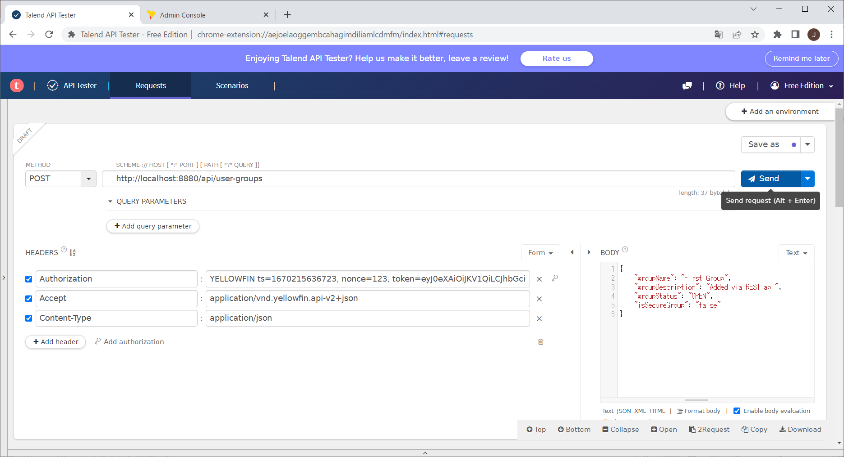
1. Create a new user group via REST API. Required header and body information is sent to Yellowfin server as POST request (below with API Tester).

Slide 2
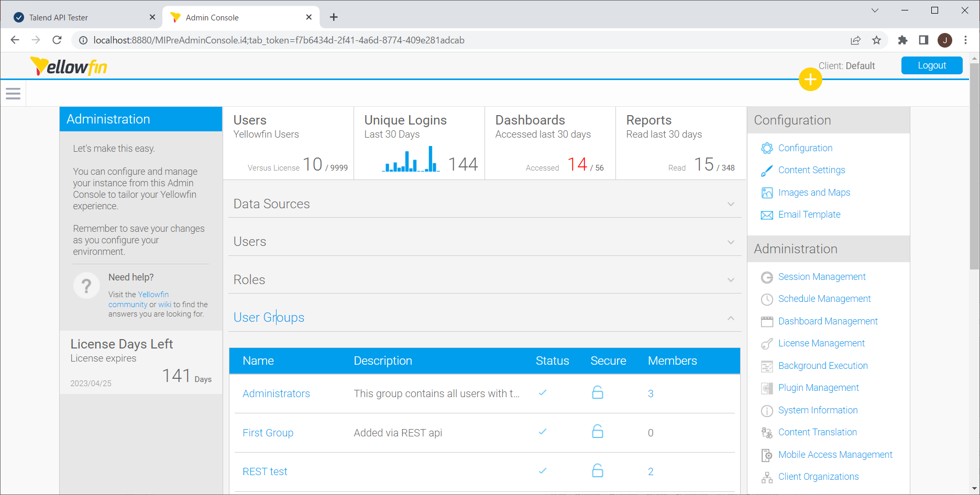
2. A new user group is created and its member is empty.

Slide 3
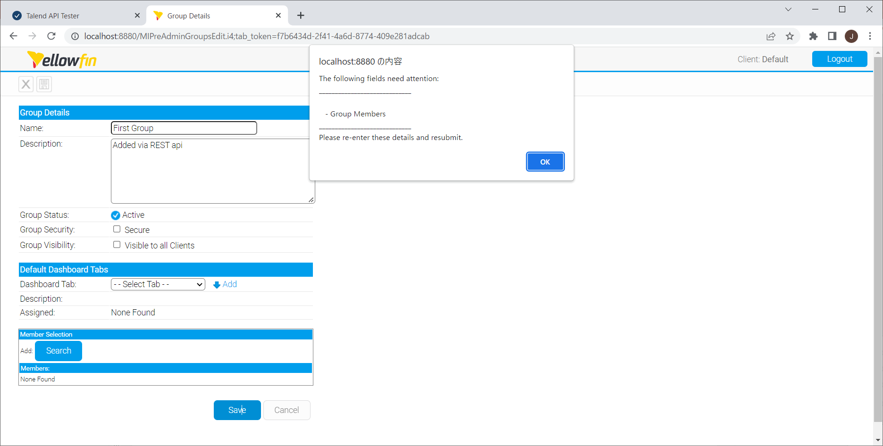
3. Once this member is selected, it cannot be saved before adding one or more members.

